Slide 1
Bitcoin-Price-Prediction
Using LSTM

Slide 2
Problem Statement:
The goal of this project is to develop an LSTM-based machine learning model that accurately predicts the closing price of Bitcoin in order to assist investors and traders in making informed decisions. By leveraging the power of LSTM, which excels at capturing sequential dependencies, we aim to improve the precision and reliability of Bitcoin price prediction.

Slide 3
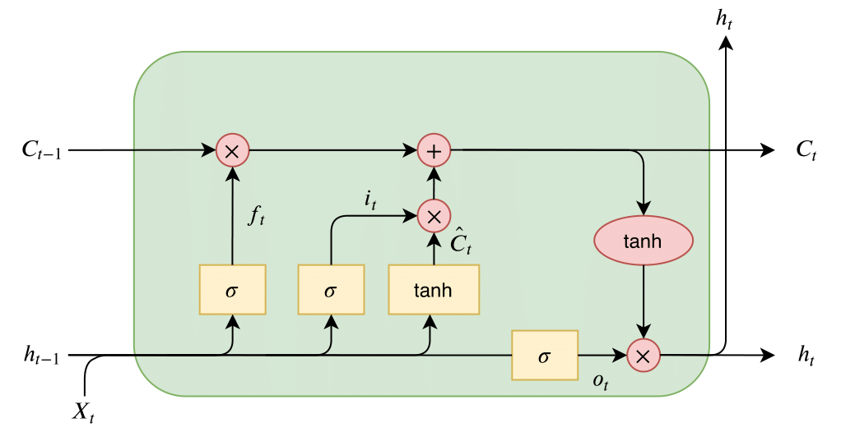
LSTM(Long-Short Term Memory)
Long Short- Term Memory (LSTM) networks are a modified version of recurrent neural networks.
Specially designed to handle Sequential data, such as time series, speech & text
By default retain the info of long gap period of time.

Slide 4
Gates
Input gate : determines how much new information should be stored in the memory cell.
Forget gate : Regulates which information in the memory cell should be discarded or forgotten.
Output gate : Determines the amount of information to be output from the memory cell.
Cell state : Long Term Memory - Storage unit that retains information over long sequence.
Hidden state : Short Term Memory – Represents the output at particular time step.

Slide 5
Packages and Models:
OS : Interacting with Operating systems.
Pandas : Data manipulation and analysis.
Numpy : Numerical operations.
Tensorflow : Model building and training in Deep Learning models.
Keras : Provides user friendly interface.
Sequential : Creating sequential models.
Dense : Fully connected layers in Neural Network.
Dropout : Sets fraction of input to ‘0’.
Matplotlib : Creating Visualizations.
Sklearn : Provides comprehensive set of tools for Machine Learning tasks.
ReLU(Rectified Linear Unit) : Activation function in Neural Network.
Adam : Optimization algorithm that adapts learning rate during training.

Slide 6
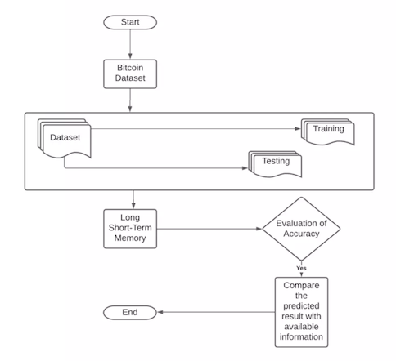
System Architecture

Slide 7
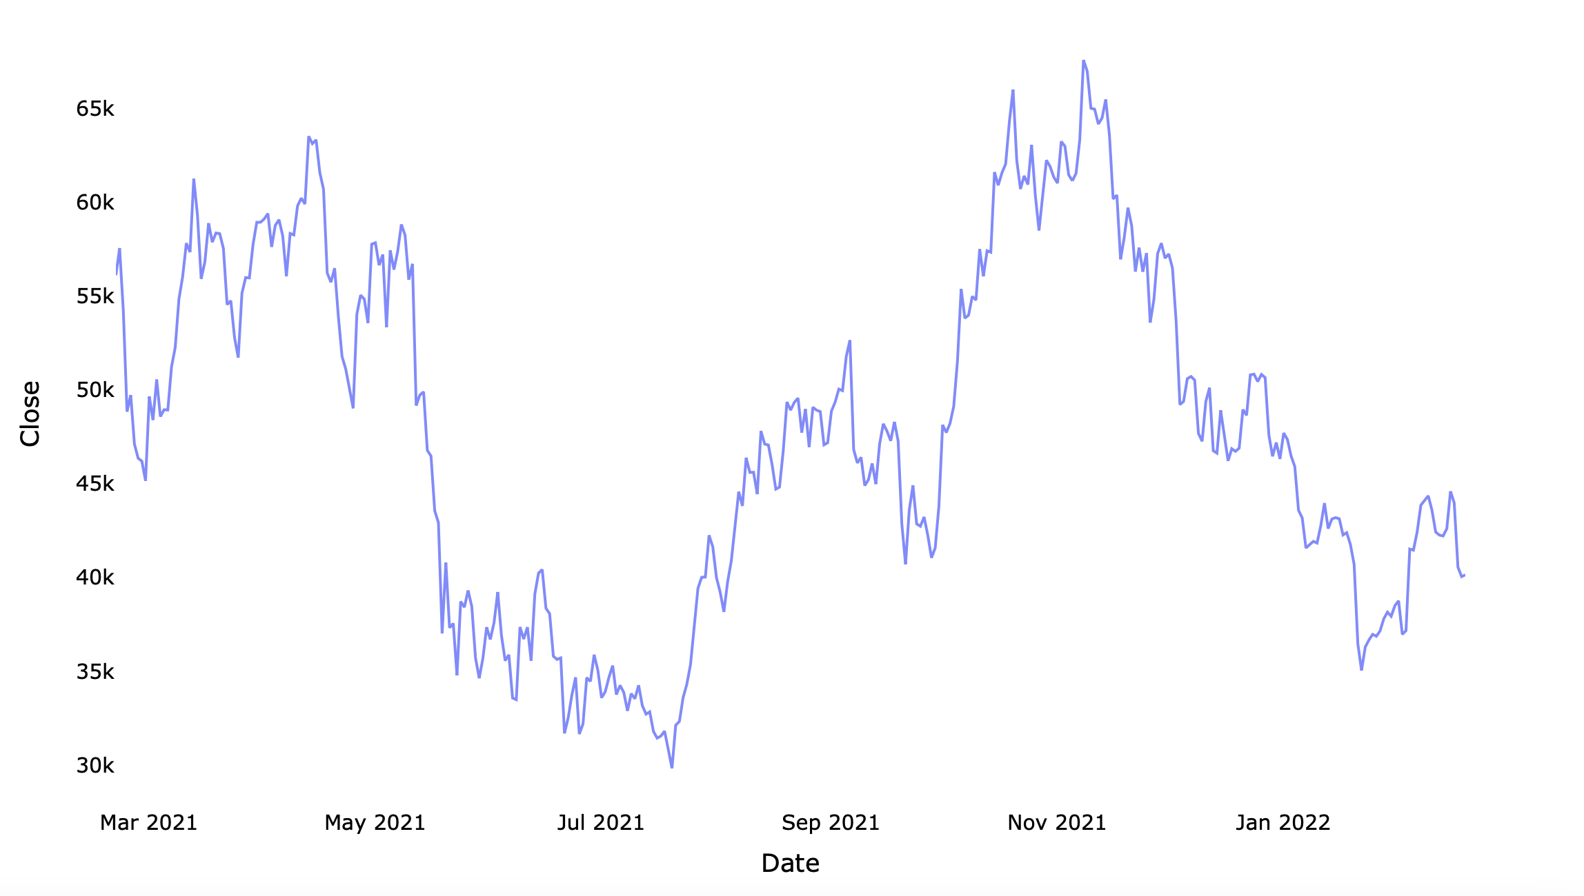
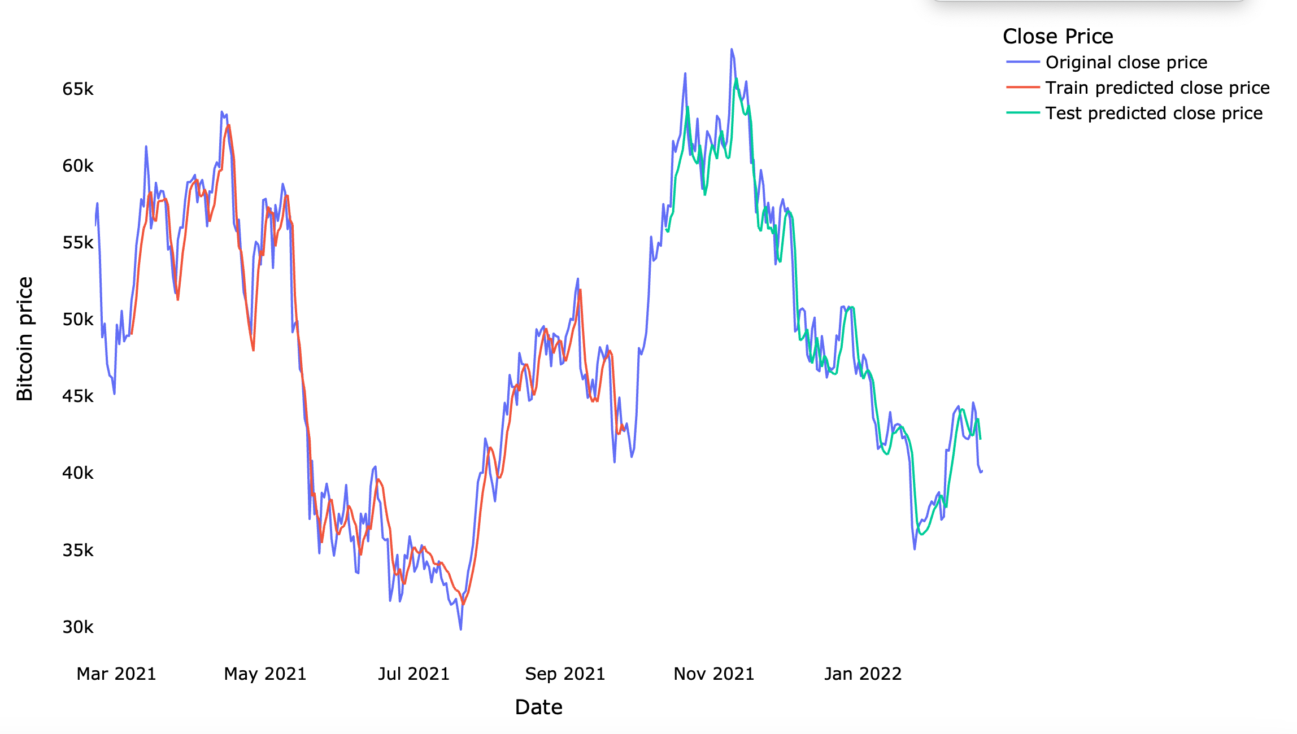
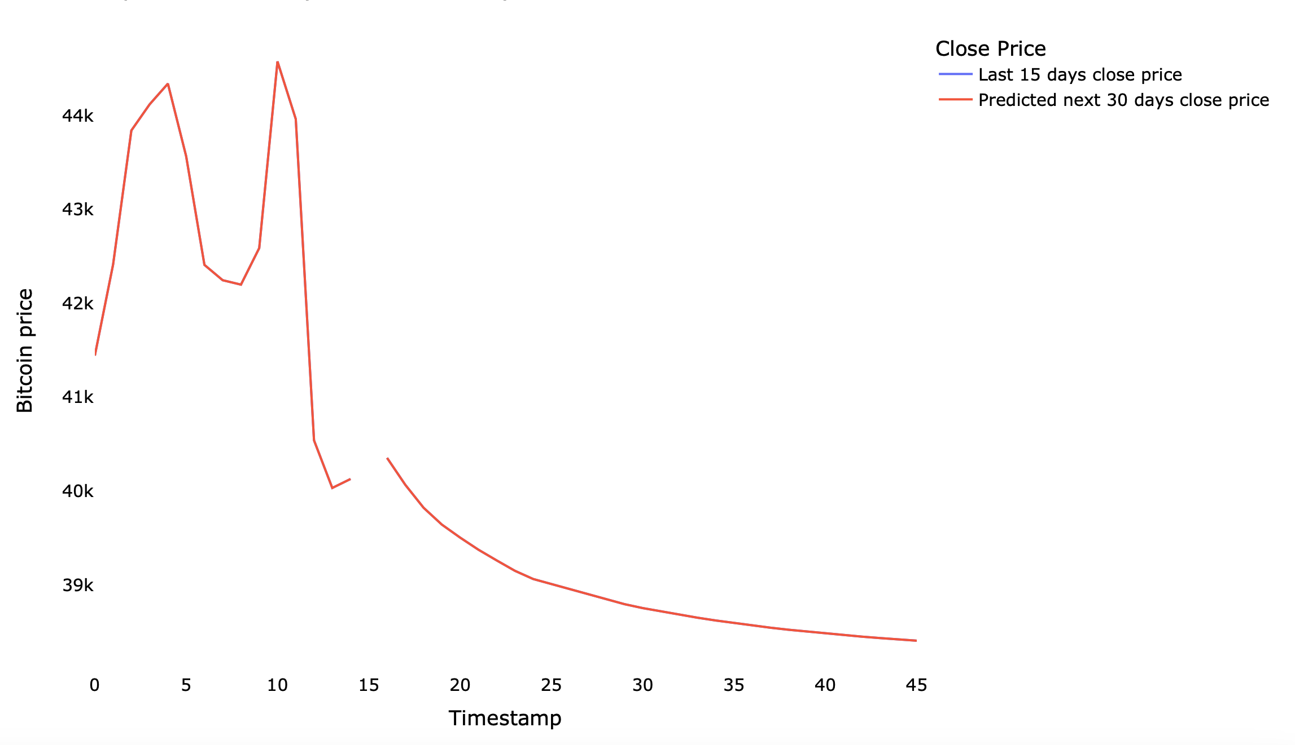
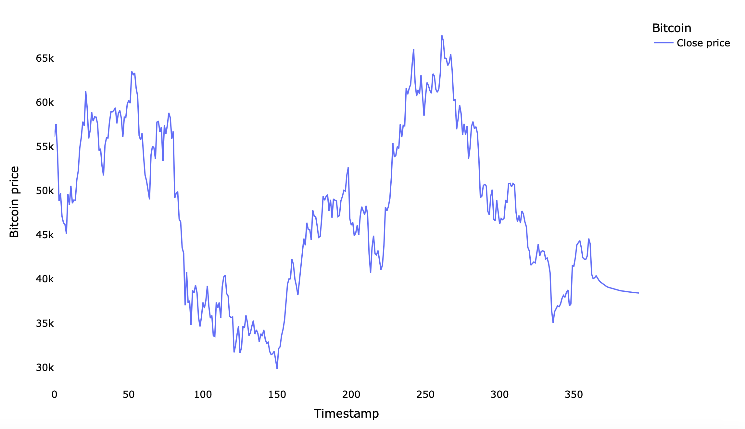
Considered period to predict Bitcoin Close price-2021
Comparison of original close price vs predicted close price
Last 15 days vs next 30 days
Bitcoin closing price with prediction

